Slide 1


Choosing Among CRC Screening Tests

Slide 2
Outline
Primer on Colorectal Cancer Screening
  CRC: the numbers
  CRC: the science
  Screening and Prevention Approaches
    Guideline based approach
    Pros and cons
Take home points
Questions and discussion

Slide 3
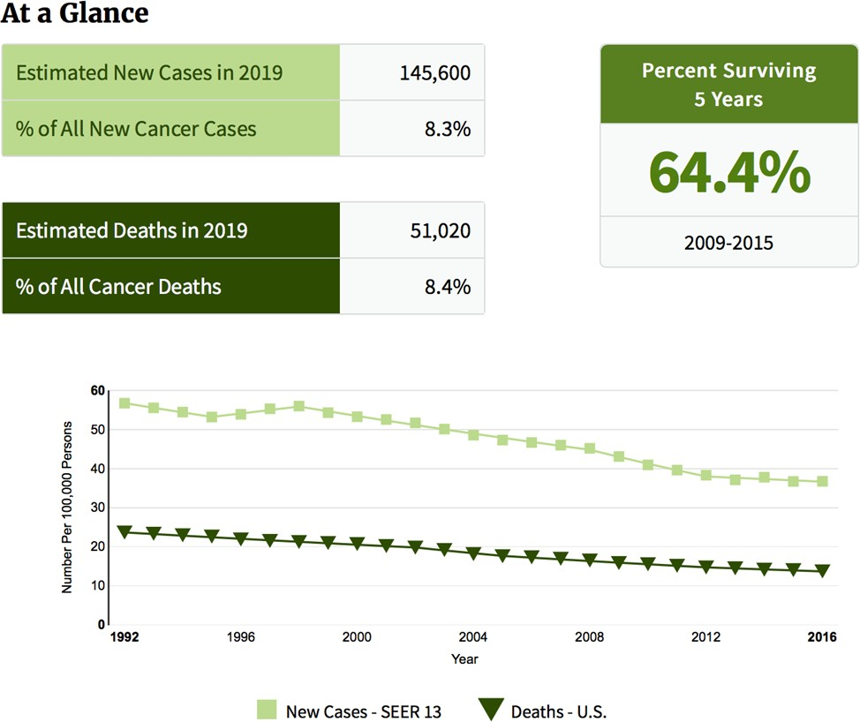
CRC: The Numbers

Slide 4
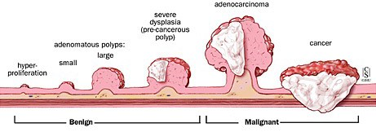
Why is CRC Easier to Screen and Prevent?
Adenoma to Carcinoma Sequence
Fewer than 10% of all adenomas become cancerous. However, more than 95% of colorectal cancers develop from adenomas
Johns Hopkins Online

Slide 5
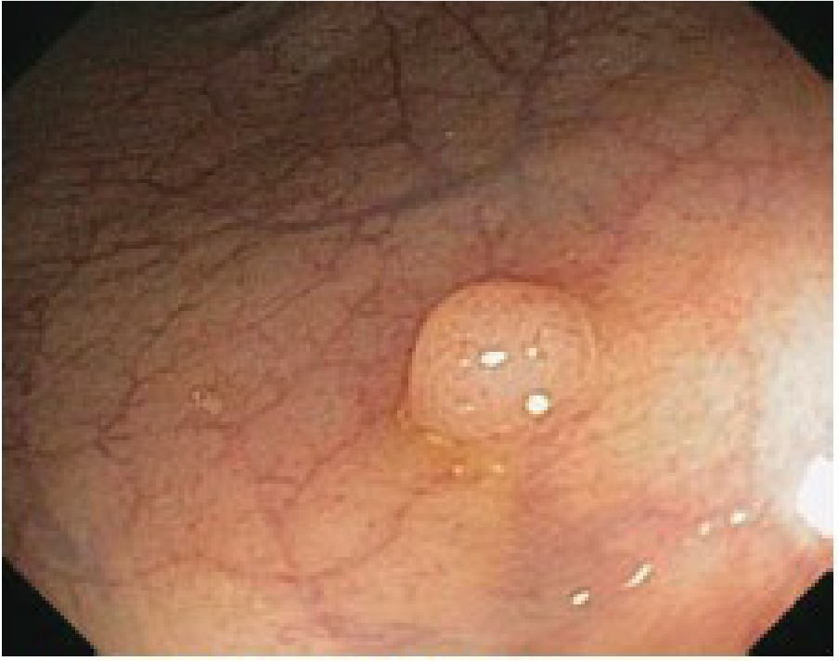
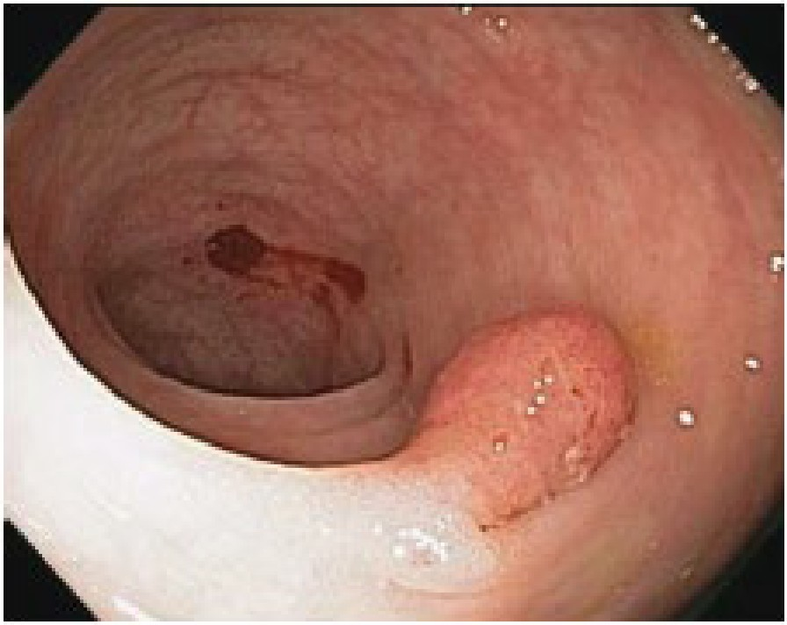
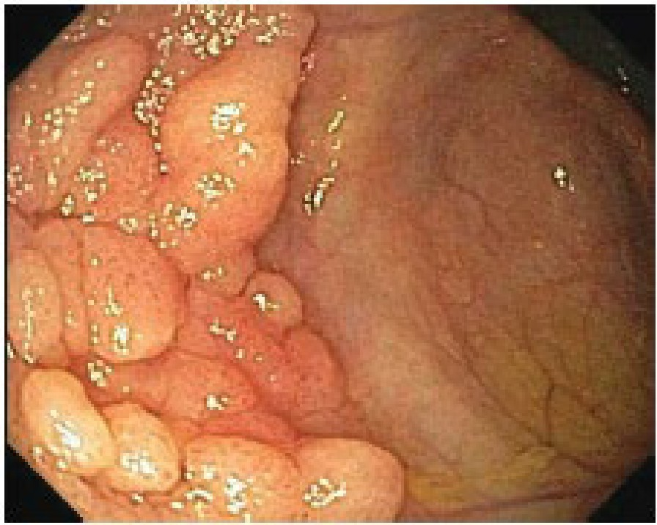
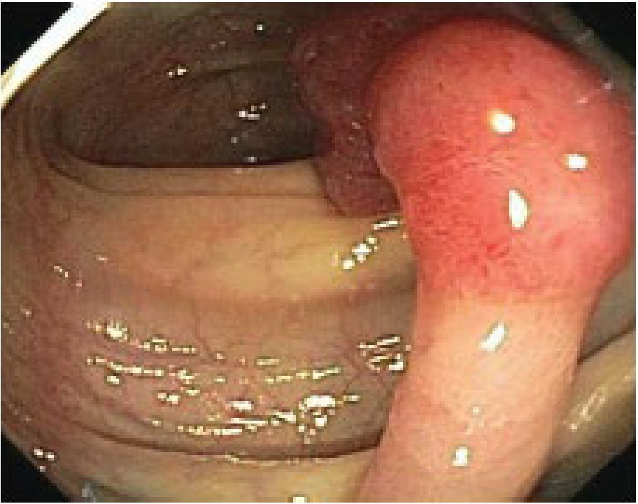
Figure 1. Tubular adenoma
Figure 2. Tubular adenoma (pedunculated)
Figure 3. Tubular adenoma (sessile)
Figure 4. Tubular adenoma with high grade dysplasia

Slide 6
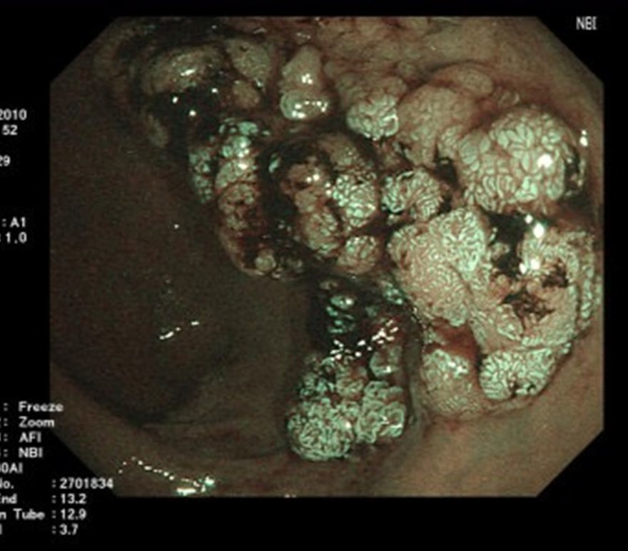
Villous Adenoma

Slide 7
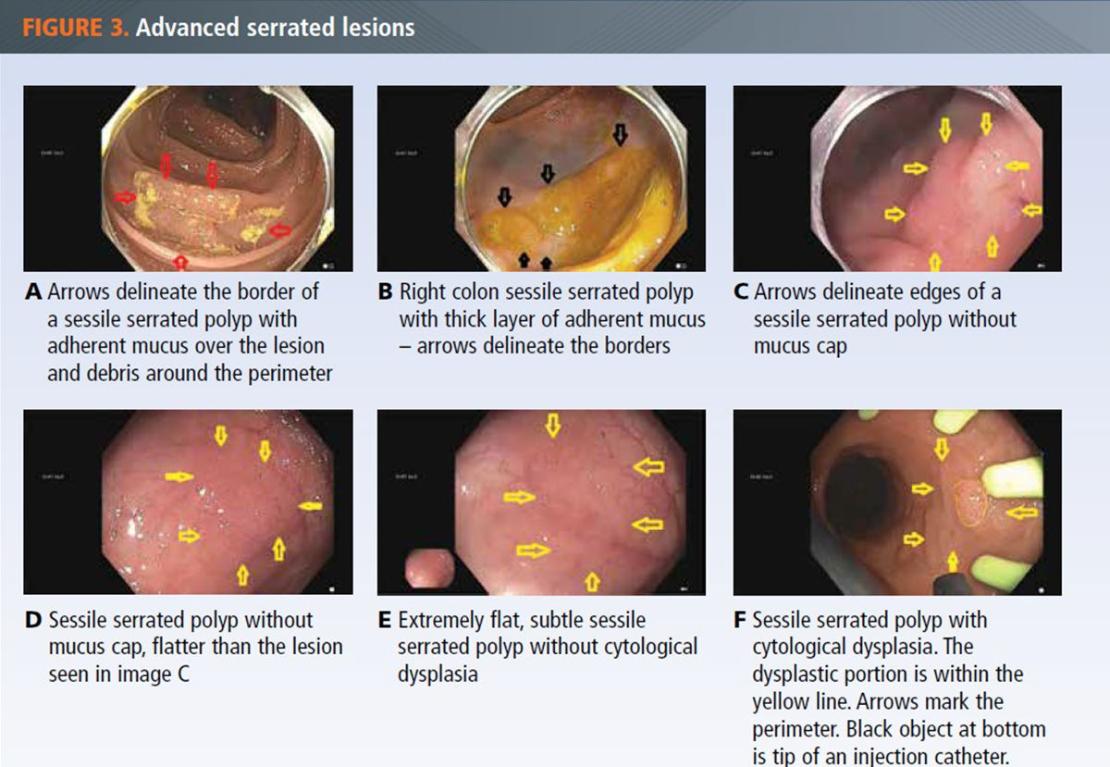
Rex, D. PRACTICAL ADVICE FOR COLORECTAL CANCER SCREENING. GI & Hepatology News 2019

Slide 8
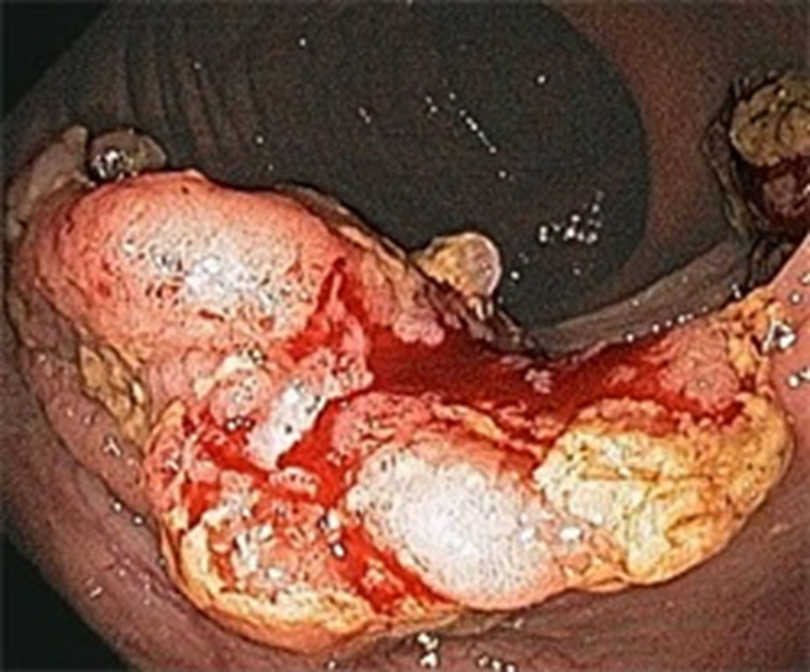
Colon Cancer

Slide 9
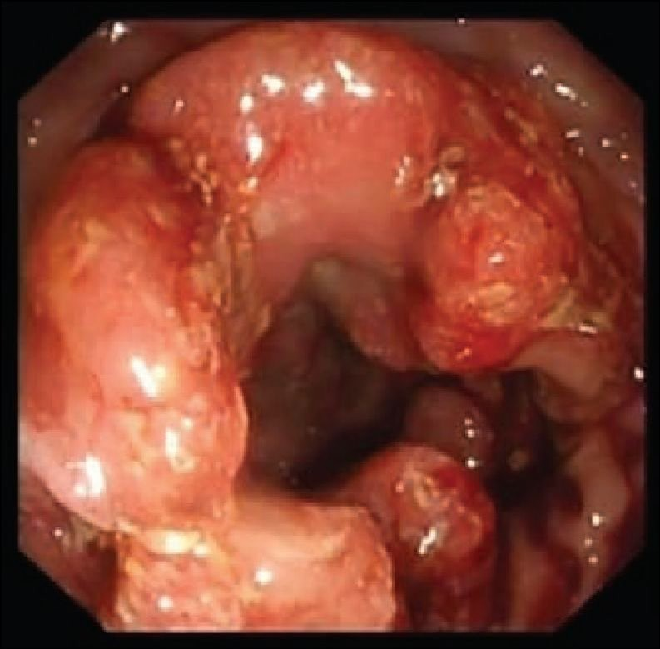
Colon Cancer

Slide 10
CRC: The Numbers
Rates of new colon cancer
Down 30%!!! between 2000-2010
  50-80 year olds
Parallels widespread use of colonoscopy
Success!!

Slide 11
CRC Screening Success! Not So Fast
> 20,000,000 eligible Americans are NOT screened
  Nearly 50% of patients who should be screened
  Access, cost, reluctance?
“My doctor didn’t mention it!!”
  #2 reason given by patients surveyed
  <10% of patients eligible were told about screening
  More than half of Medicare patients surveyed had almost 5 visits that year
    Seeff LC et al., 2004; Shapiro JA et al., 2008; Shapiro JA et al., 2012
    2010 NHIS; Klabunde CN et al., submitted
    Schenck AP et al., Prev Chron Dis, 2011

Slide 12
Screening Comparisons
We can prevent getting colon cancer
  60-90% !!!
    With colonoscopy
    That’s preventing it, not detecting it early
Mammogram (50-69 year olds)
  Death is 40% preventable
  Mammograms miss 1 in 5 cancers
  50% of women will have a false positive over 10 years
PSA for prostate screening
  Decreases dying from prostate cancer by 21%
1. Am J Gastroenterol. 2016 Jan 12.
2. N Engl J Med 2015; 372:2353-2358
3. Cochrane Database Syst Rev. 2013

Slide 13
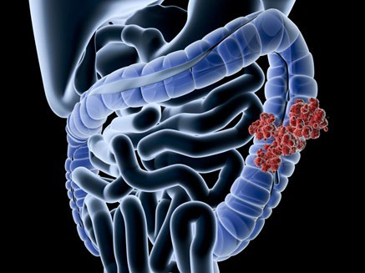
CRC: Younger Patients
Incidence of colon cancer in patients <50 is rising!
Between 2008-2011
  1 in 7 colon cancers
  Presented with more advanced disease
1. Cancer. 2016 Mar 15;122(6):929-34.
2. Prev Chronic Dis. 2015 May 21;12:E80

Slide 14




CRC: Younger Patients
Predictions by 2030
  1 in 4 >1 in 10 of all colon cancers
  of all rectal cancers
20 to 34 years olds
Increase
Colon cancer
Rectal cancer
90%
124%
28%
46%
34 to 49 year olds
Colon
Rectum
JAMA Surg. 2015 Jan;150(1):17-22.

Slide 15
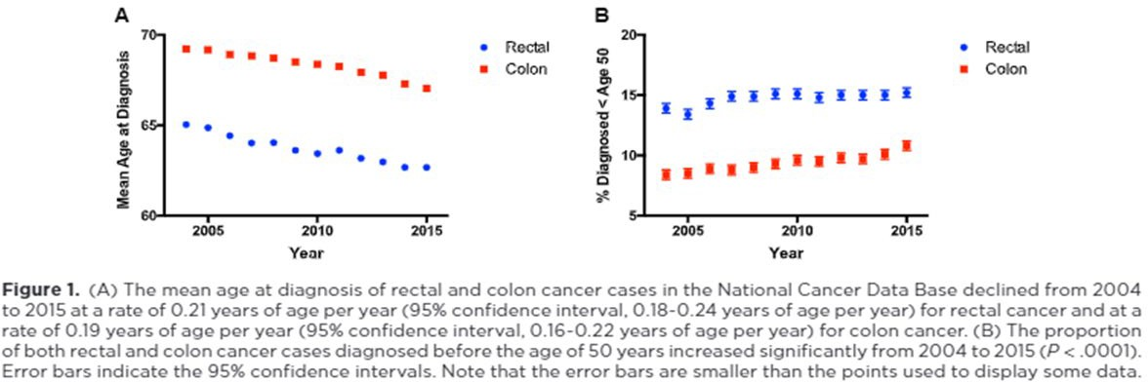
CRC: Younger Patients
Incidence of colon cancer in patients <50 is rising!
Between 2004-2015, 12% of all CRC occurred in < 50 year olds
John Virostko, Anna Capasso, Thomas E. Yankeelov, Boone Goodgame. Cancer, 2019

Slide 16
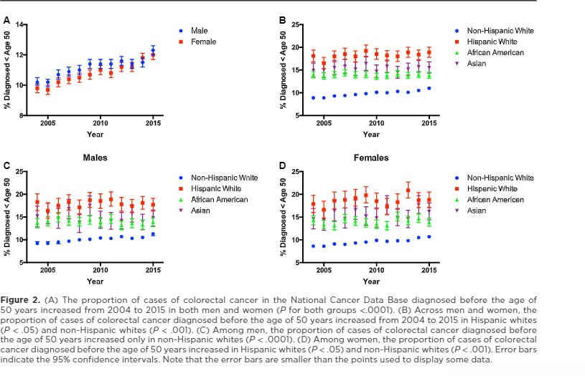
CRC: Younger Patients
John Virostko, Anna Capasso, Thomas E. Yankeelov, Boone Goodgame. Cancer, 2019

Slide 17
CRC: Younger Patients
Reason for increased rates
  Obesity epidemic
  Ethnic differences (California database)
    Higher risk in African Americans
    Lowest overall rate in Hispanics
      But greatest acceleration in incidence
Undiagnosed hereditary colon cancer syndromes
  5-8% of patients
  92% of patients would not have a family history
Environmental exposures
Antibiotic use?
J Adolesc Young Adult Oncol 3:176-184, 2014.
John Virostko, Anna Capasso, Thomas E. Yankeelov, Boone Goodgame. Cancer, 2019

Slide 18
What Can’t Be Changed
Age
Racial & ethnic background
Personal history of Colon Cancer/Polyps
Personal history of Ulcerative Colitis or Crohn’s disease of the colon
Family history of Colon Cancer/Polyps
Inherited syndromes
  Familial Adenomatous Polyposis (FAP)
  Lynch Syndrome (HNPCC)
Source: American Cancer Society

Slide 19
What Can Be Changed
Diet
  Limit/avoid red meat & processed meat (deli meats)
  Increase daily vegetables and fiber
Increased Physical Activity
Weight loss through proper diet & exercise
Control Type II Diabetes
Quit Smoking
Limit alcohol use
Get screened for colon cancer
Source: American Cancer Society

Slide 20
Average Risk Screenimg
Start at age 50
African Americans: start at age 45
American Cancer Society
  Start at age 45 for everyone
  Controversial
Systematic review of colorectal cancer screening guidelines for average-risk adults: Summarizing the current global recommendations. World Journal of Gastroenterology 2018 Jan 7;24(1):124-13

Slide 21
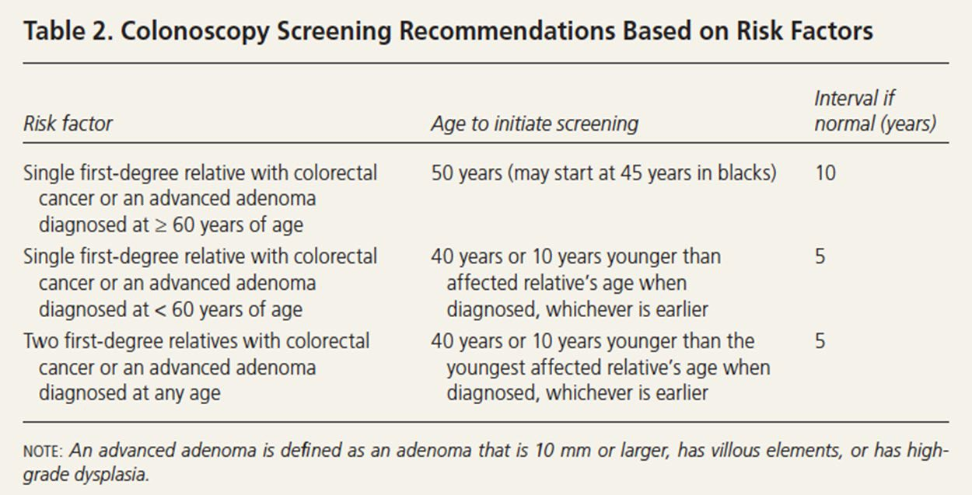
High Risk Screening
Rex DK, Boland CR, Dominitz JA, et al. Colorectal cancer screening: recommendations for physicians and patients from the US Multi-Society Task force on Colorectal Cancer. Gastroenterology. 2017;153(1):307-323.

Slide 22
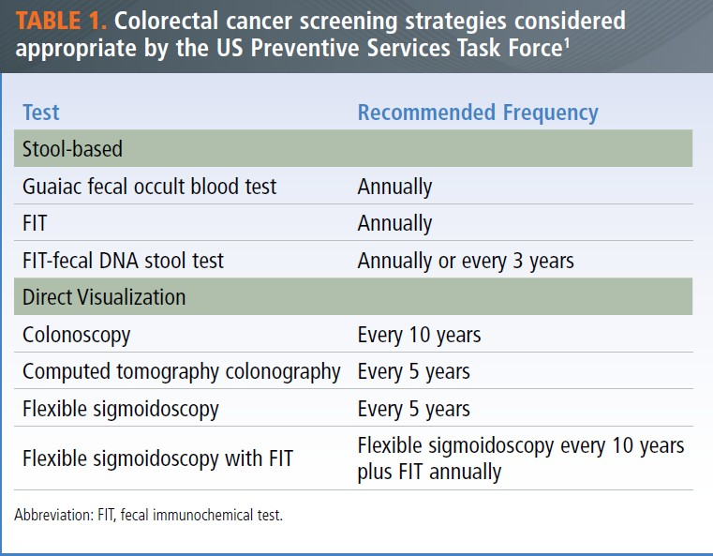
CRC Screening Options
US Preventive Services Task Force, Bibbins- Domingo K, Grossman DC, et al. Screening for colorectal cancer: US Preventive Services Task Force recommendation statement. JAMA. 2016;315(23):2564-2575.

Slide 23
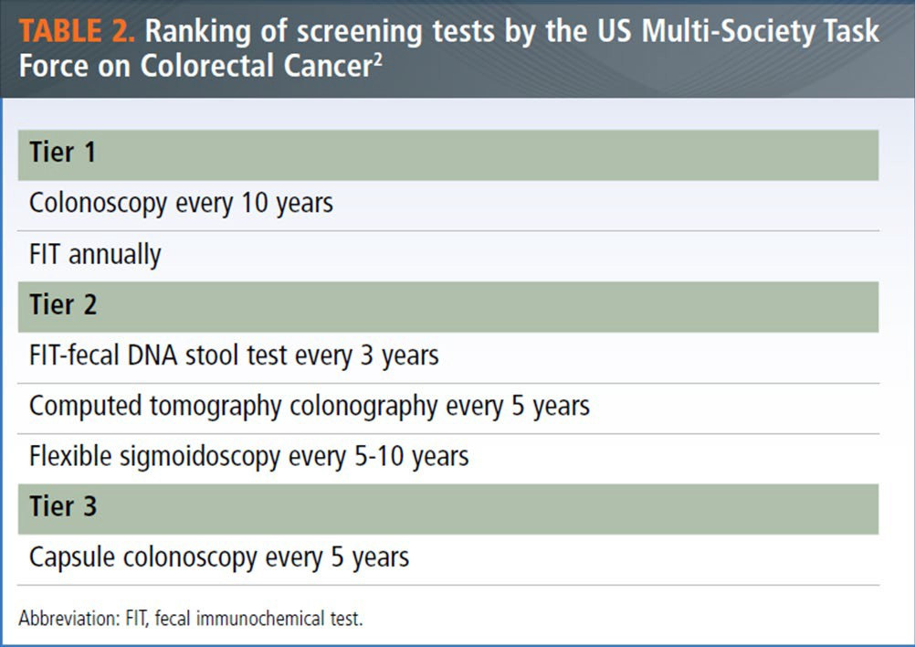
CRC Screening Options
Rex DK, Boland CR, Dominitz JA, et al. Colorectal cancer screening: recommendations for physicians and patients from the US Multi-Society Task force on Colorectal Cancer. Gastroenterology. 2017;153(1):307-323.

Slide 24
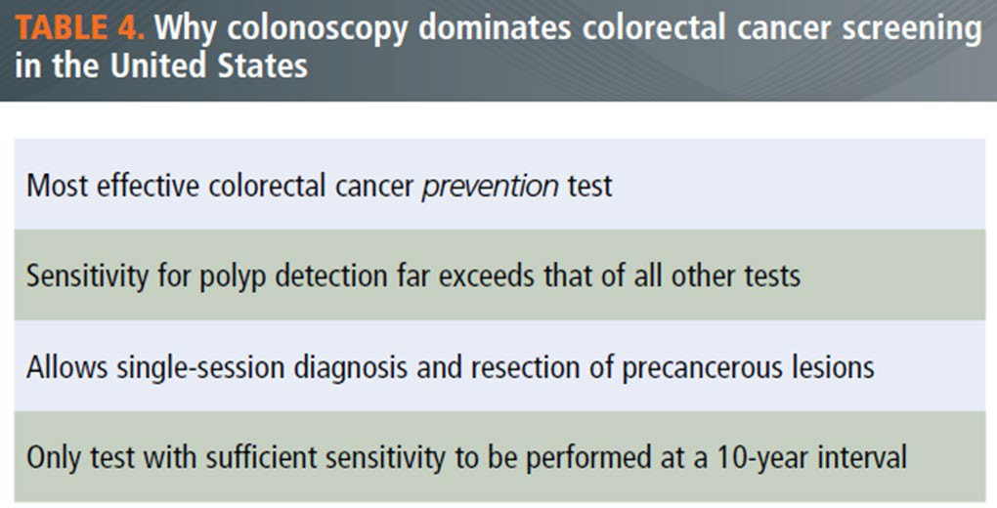
Colonoscopy – The GOLD Standard
Colonoscopy detects:
  3x more advanced lesions than FIT
  2x more advanced lesions than FIT-fecal DNA
Rex, D. PRACTICAL ADVICE FOR COLORECTAL CANCER SCREENING. GI & Hepatology News 2019

Slide 25
Reasons Patients Delay Colonoscopy
Invasive
Concern for intolerance of prep
Concern for safety of procedures
Self-conscious of body image
Logistics
  Day off work plus driver
Costs
  High deductible or co-pays

Slide 26
Colonoscopy Risks
Major complications for average risk screening
Cardiopulmonary
  < 1%
Perforation (0.3-0.07%)
  1 in 2,000 is considered standard of care (0.05%)
Source: ASGE Guidelines 2011

Slide 27
Colonoscopy Risks
Major Bleeding After a Polyp is Removed
Standard of care:
ASGE:
1 in 100 (1%)
2 in 1,000 (0.5%)
Death directly attributable to colonoscopy
  19 in 284,000, or 0.007%
Source: ASGE Guidelines 2011

Slide 28
Colonoscopy Summary
Safe & well tolerated
By far the most sensitive test
The only test that prevents colon cancer
Should be the first test offered to average risk patients
The only test recommended for high risk patients
Should be done by high performing GI

Slide 29
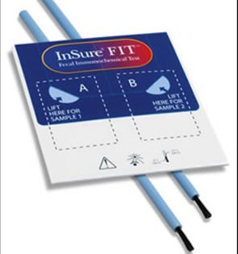
Fecal Immunochemical Test (FIT)
Stool test that checks for
  Hemoglobin
Assumes cancers will bleed
Once a year
Requires stool sample be obtained

Slide 30
FIT Testing
Threshold for detection of hemoglobin
  20 μg/gram feces
Advantages
  Done at home
  Low cost - $22
  Better adherence in organized settings (Kaiser)
If threshold for hemoglobin 10 μg/gram feces
Sensitivity for cancer
Specificity for cancer
91%
90%

Slide 31
FIT Testing - Take Home Points
Low cost
Easy to use
Good (but not great) sensitivity for CRC
  Much improved if decreased for hemoglobin threshold
Colonoscopy is needed if test is positive
Only prevents cancer when it results in colonoscopy

Slide 32
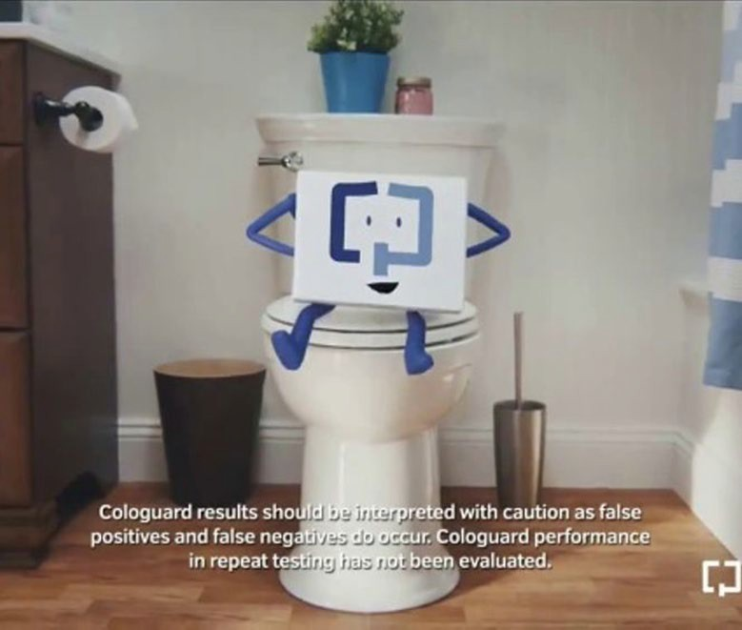
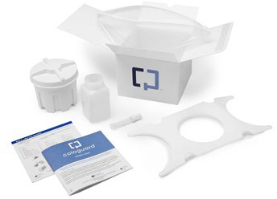
FIT-Fecal DNA Test (Cologuard^{®)}

Slide 33
FIT-Fecal DNA
Combination of FIT-fecal DNA
  Fecal DNA
    Methylation Markers
Intended for:
  Average risk colon cancer screening (ages 50-85)
Cologuard is NOT recommended if:
  Adenomas on prior colonoscopies
  Family history of colon cancer or advanced polyps

Slide 34
FIT-Fecal DNA
If FIT-fecal DNA is negative (normal)
  Needs to be repeated every 3 years
Advantages over colonoscopy:
  Done at home
  No preparation needed
  No days off work
  No driver needed
Colonoscopy is needed if test is positive

Slide 35
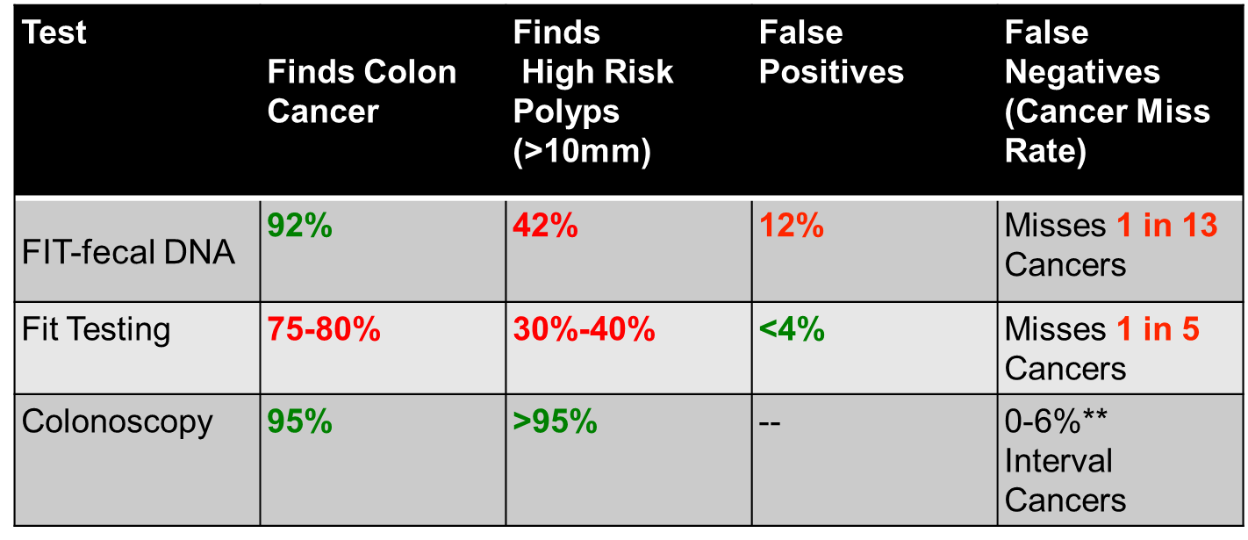
CRC Screening Comparisons
Robertson DJ, Lee JK, Boland CR, et al. Gastrointest Endosc. 2017;85(1):2-21.e3.
Imperiale TF, Ransohoff DF, Itzkowitz SH, et al. N Engl J Med. 2014;370(14):1287-1297.

Slide 36
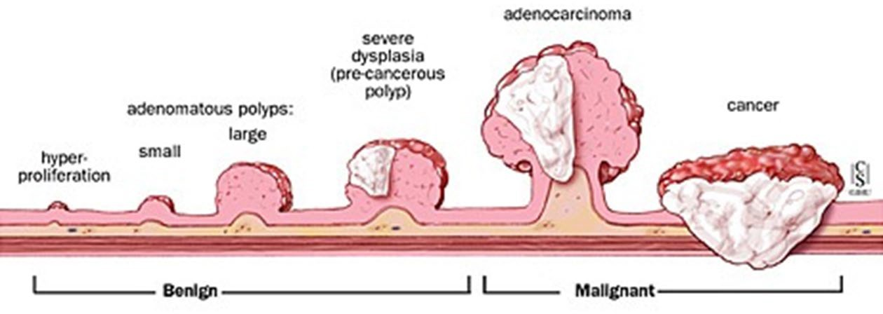
FIT-Fecal DNA Misses Polyps and Cancer
More than 30% of polyps that will soon become cancer
Imperiale TF, Ransohoff DF, Itzkowitz SH, et al. N Engl J Med. 2014;370(14):1287-1297.

Slide 37
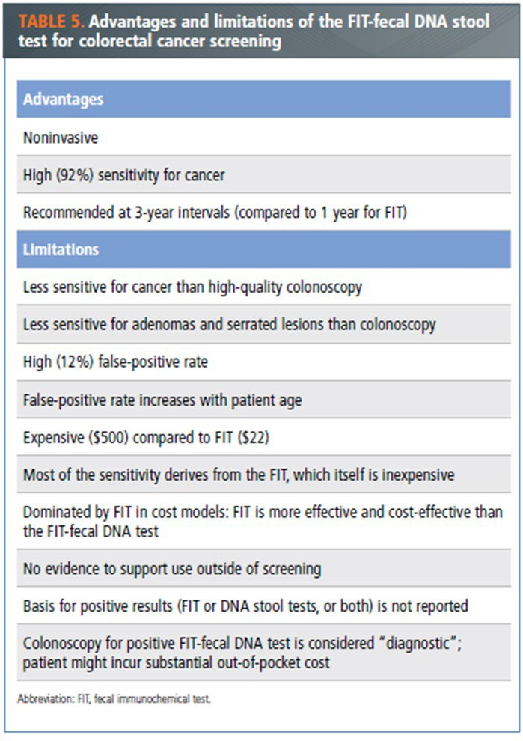
Rex, D. PRACTICAL ADVICE FOR COLORECTAL CANCER SCREENING. GI
& Hepatology News 2019

Slide 38
FIT-Fecal DNA Take Home Points
Easier than a colonoscopy
Misses in 1 in 13 colon cancers
Misses > 30% of polyps that will become cancer
Misses almost 60% of polyps that could turn into cancer
Only prevents colon cancer if it results in colonoscopy and polyp removal
Imperiale TF, Ransohoff DF, Itzkowitz SH, et al. N Engl J Med. 2014;370(14):1287-1297.

Slide 39
FIT-Fecal DNA Take Home Points
Easier than a colonoscopy
Misses in 1 in 13 colon cancers
Misses > 30% of polyps that will become cancer
Misses almost 60% of polyps that could turn into cancer
Only prevents colon cancer if it results in colonoscopy and polyp removal
Imperiale TF, Ransohoff DF, Itzkowitz SH, et al. N Engl J Med. 2014;370(14):1287-1297.

Slide 40
Take Home Points
Colon cancer is common and deadly
Colon cancer rates are rising for younger patients
Colon cancer and death is nearly entirely preventable
But 50% of eligible patients are not screened
ANY SCREENING IS BETTER THAN NO SCREENING…but

Slide 41
Take Home Points
Colonoscopy remains the only test that prevents cancer of entire colon.
  Start at age 50
  African Americans - begin at age 45
  Family history of colon cancer/advanced polyps
  Colonoscopy age 40 or 10 years before diagnosis
    Whichever is younger
For patients who refuse colonoscopy
  FIT testing every year is the next recommendation
Then…
FIT-Fecal DNA
  Important alternative test with important limitations

Slide 42

Content developed by Ilche Nonevski, MD and Joseph Vicari, MD, MBA, FASGE at Rockford Gastroenterology Associates

