Slide 1



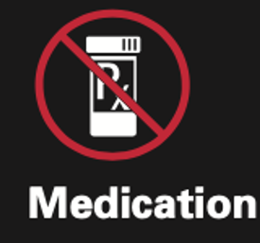
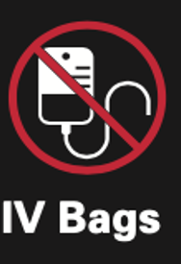

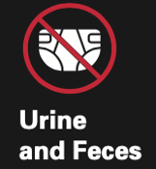
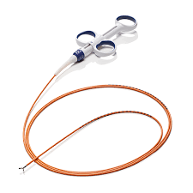
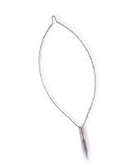
Hazardous Waste
(Regulated Medical Waste)
YES
NO
Blood-soaked pads or gauze
Bloody effluent
Blood filled syringe
Blood transfusion tubing
∅ Forceps with protected sheath
Snares
Suction canister
∅ Materials that are not soaked in blood

Slide 2
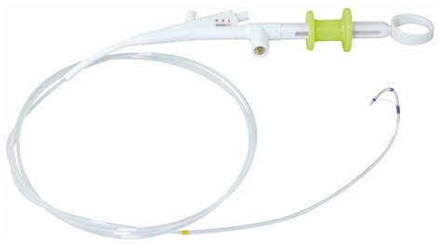
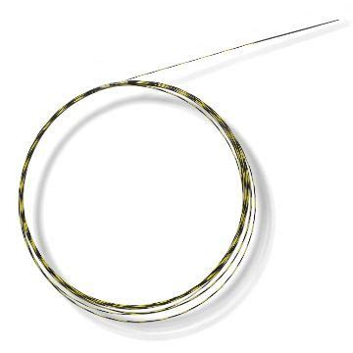
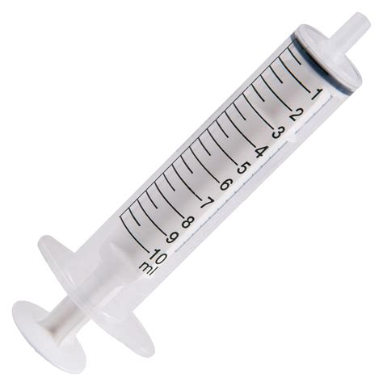
Sharps
YES
NO
ü Needles (IV, FNA)
ü Scissors/Scalpels
ü Broken glass vials
ü Capillary tubes
ü Forceps with exposed spike
∅ Wires/Snares
∅ Forceps with protection sheath
∅ Sphincterotomes
∅ Used IV catheters
∅ Empty syringes without needle

Slide 3
Trash (Landfill Waste)
YES
NO
Examples:
∅ Sharps
∅ Material soaked in blood
Recyclable materials (cardboard, etc.)
Gloves, gowns
Gauze, underpads
Tubing/IV bags/syringes (empty)
Bite blocks
Endoscopy buttons, biopsy channel valve cap
Biopsy forceps with sheath protection, snares
Guidewires/sheaths/catheters
Sphincterotomes, plastic stents
NG tubes, PEG tubes
Suction canister (with solidified effluent)

Slide 4
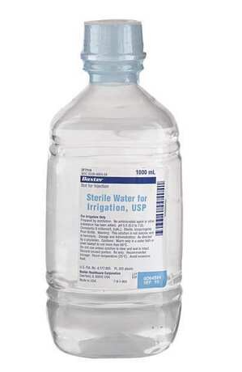
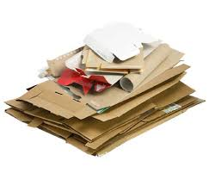
RECYCLING
YES
NO
Cardboard (packaging)
Paper (inserts)
Plastic bottles, containers
(per local guidance)
∅ Plastic bags
Any material that has been in contact
with the patient
Gloves
Gowns
[per local guidance]

